Slide 1
C++(Object Oriented Programming)
Prateek Pudasainee

Slide 2
Recap
Fundamental vs Derived Data types.
Strings.
Arrays.
Vectors.

Slide 3
Contents
Loops.
Functions.
OOP recap
OOP constructs(class, objects, attributes, methods)

Slide 4

Types of Loops*
for Loop
Best when number of repetitions is known.
Used commonly for index-based iterations.

Slide 5

Types of Loops*
While loop
Executes as long as the condition is true.
Useful when the number of repetitions is not known beforehand.

Slide 6
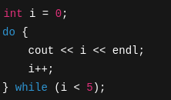
Types of Loops*
do-while loop
Executes the block at least once, then checks the condition.
Ideal when you want the code to run at least one time no matter what.

Slide 7
Nested Loops*
Loop inside a loop.
Useful when dealing with multidimensional operations.

Slide 8
Function
A function is a block of reusable code that performs a specific task.
Why function?
Modularity.
Reusability.
Cleaner Code.
Ease of Maintenance.

Slide 9
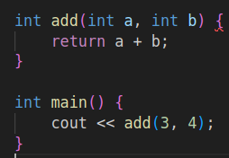
Function*

Slide 10

Pass by value*
A copy of the variable is passed to the function.
Changes made inside the function do not affect the original variable.

Slide 11

Pass by reference*
The actual variable is passed to the function using a reference (&).
Changes inside the function affect the original variable.

Slide 12
Function Overloading*
Function overloading allows you to define multiple functions with the same name but different parameter lists.
Overloading can be on based on :
Number of parameters.
Types of parameters.

Slide 13
Recursive function*
A recursive function is a function that calls itself to solve a smaller version of a problem.
Base case and recursive case.
Factorial of a number demo.

Slide 14
OOP

Slide 15
OOP
Why Object-Oriented Programming?
Real-world modeling.
Encapsulation, polymorphism, inheritance and abstraction.
Keeps code organized, modular, and scalable
Teams can work on separate components
Benefits of OOP
Architecture
Team collaboration
Scalability

Slide 16
OOP
OOP constructs:
Classes
Objects
Attributes
Methods

Slide 17
Classes and objects
A class is a blueprint for creating objects in C++.
It defines:
Attributes: The data or properties that the object will hold.
Methods/Functions: The actions or behaviors the object can perform.
Object is an instance of a class. Real-world representation of that class, with its own set of data (attributes).

Slide 18
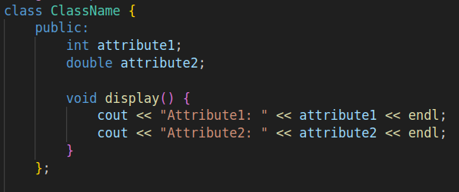
Syntax for class *

Slide 19
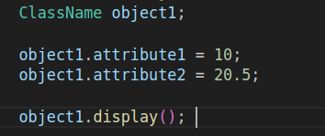
Syntax for creating objects

Slide 20
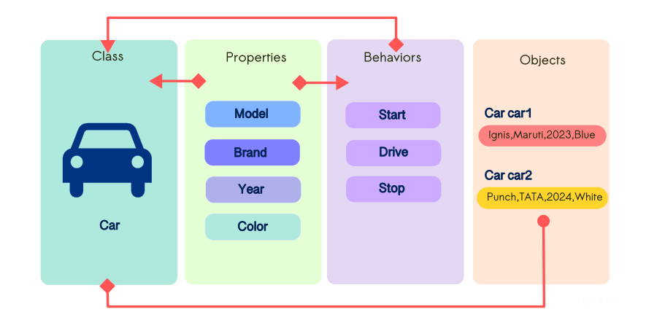
Real World Example

Slide 21
Activity
Create a Simple Bank system where you deposit money , withdraw and check balance.
Start with 0 balance.

Slide 22

Quiz
What is the output of the following code?
1 2 3
0 1 2
01 2 3
Infinite loop

Slide 23
Quiz
Which loop is guaranteed to execute at least once, even if the condition is false initially?
for loop
while loop
do-while loop
All of the above

Slide 24
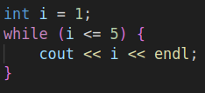
Quiz
What is wrong with this code?
Missing i++, causes infinite loop
while should be for
Loop will not execute
Syntax error

Slide 25
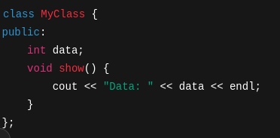
Quiz
Correct option to create object and access member function?
MyClass obj; obj.show();
MyClass obj(); obj.show();
obj = new MyClass(); obj.show();
obj = MyClass(); obj.show();

Slide 26
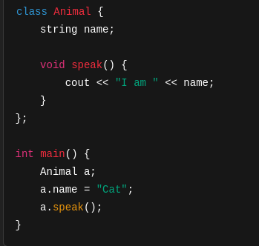
Quiz
Identify error.
No error
name and speak() should be public
Animal should be declared in main()
Cannot use dot operator on object

